Slide 1
Predicting Droughts using Weather & Soil Data
Presented By,
Akshaya Srinivasan
Manisha Paliwal
Praphul Kenkere Omkarmurthy
Sonal Sharma
Harshitha Ramesh
Image Source: https://www.insurancejournal.com/app/uploads/2022/04/drought-scaled.jpg

Slide 2

Project Background
What?
Why?
Current problem?
Solution needed?
How?
Image Source: https://www.google.com/search?q=facial+feature+extraction&tbm=isch&ved=2ahUKEwinnJ3ihM73AhWaKjQIHb_&gs_lcp=CgNpbWcQAzIFCAAQgAQyBAgAEBgyBAgAEBgyBAgAEBgyBAgAEBg6BAgAEEM6BggAEAgQHjoICAAQgAQQsQM6BwgAELEDEEM6CAgAELEDE

Slide 3







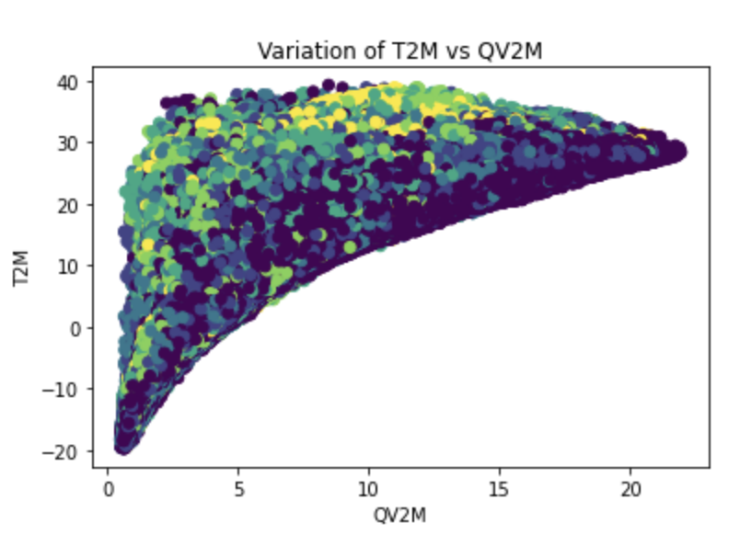
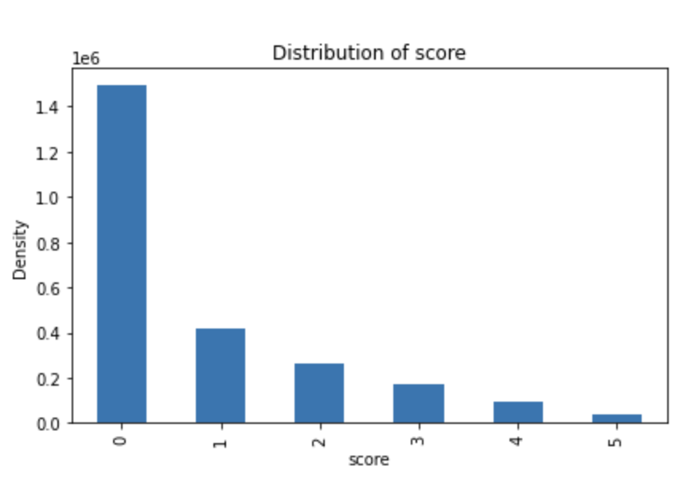
Executive Summary
Drought Prediction From Meteorological Data
10M Days Weather Data
2.7 M
Drought Entries
Data Sourcing
Collecting data from US Drought monitor
5 Drought
Levels
18 Weather Attributes
Data Cleaning
Handling missing values, outliers, reformatting and resampling data
Non-Linear and Imbalanced Data
Feature Extraction
RFE Using Random Forest, PCA and LDA
Model Development
Decision Tree, KNN, Naïve Bayes, Random Forest and SVM
Performance Comparison
Algorithm/ Metric | Accuracy | Cohen Kappa Score
Random Forest without resampling | 0.808959 | 0.654981
KNN without resampling | 0.798651 | 0.657498
KNN with SMOTE Upsampling | 0.795267 | 0.657827
Decision Tree with SMOTE Upsampling | 0.764228 | 0.607222
Decision Tree without resampling | 0.763337 | 0.596681
Naive Bayes without resampling | 0.585144 | 0.080746
SVM with Near Miss Downsampling | 0.299534 | 0.078111
Performance Comparison
Using metrics such as Accuracy, Precision, Recall, F1 Score, Kappa Score and ROC Curve

Slide 4

Literature Survey
Paper Title, Author and Publication | Objective | Methodology Used | Result
Joint Motion Information Extraction and Human Behavior Recognition in Video Based on Deep Learning, Kai Zhang and Wenjie Ling, IEEE SENSORS JOURNAL, OCTOBER 15, 2020 | Recognize human behavior using deep learning algorithm by using joint motion information | DCNN was used, static and dynamic features were extracted from images Spatial and time channel uses VGGNET16 | Boxing action has the highest accuracy of 92.12% and the least accuracy was of jogging, 51.62 % Boxing has more static features and hence its spatial interpretation is much easier compared to jogging which has more dynamic characteristics
DAiSEE: Towards User Engagement Recognition in the Wild, Abhay Gupta, Arjun D’Cunha, Kamal Awasthi and Vineeth Balasubramanian ,JOURNAL OF LATEX CLASS FILES | DAiSEE dataset was introduced publicly to determine affective states of students. | Two InceptionNet V3 models were developed. It was derived from CNN and pre- trained using ImageNet C3D model and a Long-Term Recurrent Convolutional Network was created | LRCN performed better than C3D and InceptionNet. LRCN achieved 73.5%, 72.3%, 57.9%, and 53.7% accuracy in identifying frustration, confusion, engagement, and boredom, respectively based on the comparative analysis between the models

Slide 5
Literature Survey
Paper Title, Author and Publication | Objective | Methodology Used | Result
Multimodal Student Engagement Recognition in Prosocial Games, Athanasios Psaltis, Konstantinos C. Apostolakis, Kosmas Dimitropoulos, IEEE TRANSACTIONS ON GAMES | The difficulty of detecting student interest in prosocial games through the use of engagement cues from various input modalities | SDK’s face tracking engine was used for facial extraction and a neural network was trained to categorize emotions Bimodal late fusion scheme was also used to categorize emotions based on concatenation of face features and body features | Classification accuracy was 85%, multimodal affective recognition is better than monomodal classifiers
Comparison of Papers
Deep neural networks outperform SVM models in recognizing emotions in terms of accuracy
Deep Neural Networks are better in generalizing new images
Multiple layers of convolution filters along with pooling layers had yielded greater accuracy

Slide 6


Project Management
We created a Trello Board to follow Agile Methodology and keep track of task progress

Slide 7

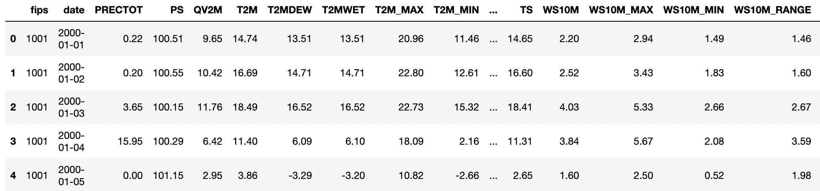
Data Collection
Sourcing data from US Drought Monitor
Meteorological data from US Drought Monitor
~10M records observed at a specific location in the US over the years
5 classes - D0 – Abnormally Dry to D4-Exceptional Drought
18 meteorological indicators as attributes
Samples of Raw Data

Slide 8

Data Pre-Processing
Removing Missing Values
Outlier Handling
Data Reformatting
Meteorological data is collected daily, but the drought scores were updated weekly
~2.7 Million records remain
Values beyond the standard outlier limit (Mean(x)±3(Std(x))) were removed
~2.5M records remain
Encoding categorical variables into numerical
Splitting Date into Day, Month and Year
Feature Selection
Handling Class Imbalance
Dimensionality Reduction
Recursive Feature Elimination technique using Random Forest Algorithm
15 best attributes are selected
60% of the total records correspond to class D0
Upsampling using SMOTE, downsampling using Near Miss
Linear methods – Principal Component Analysis and Linear Discriminant Analysis
Kernel PCA – a challenge

Slide 9

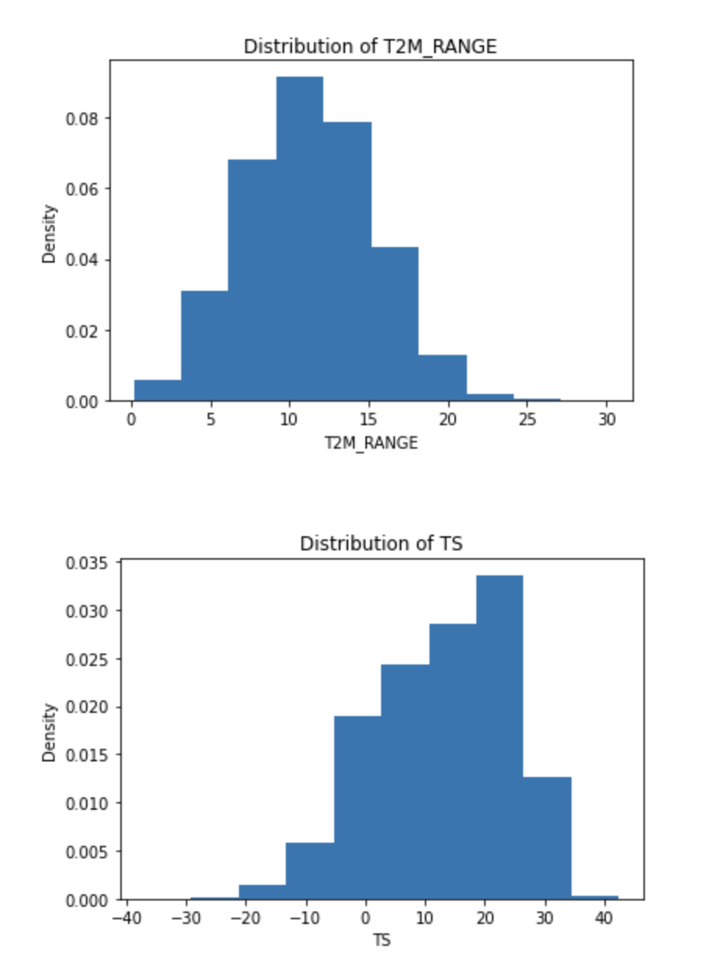
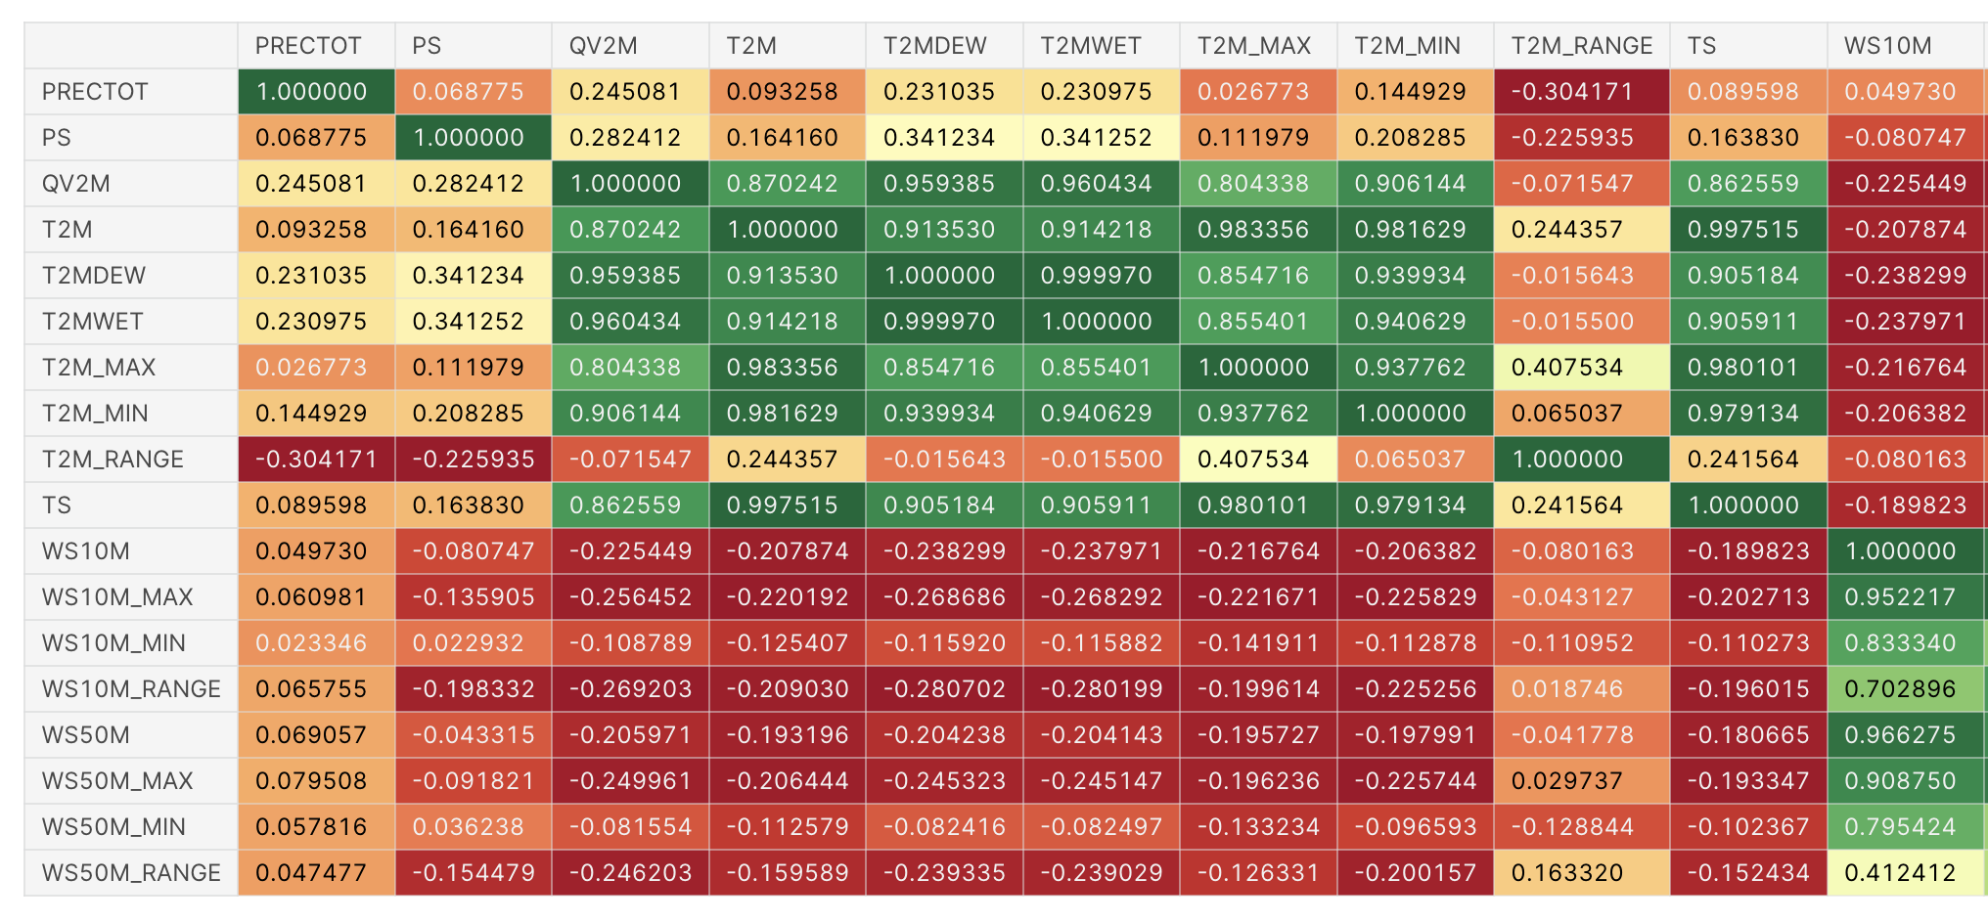
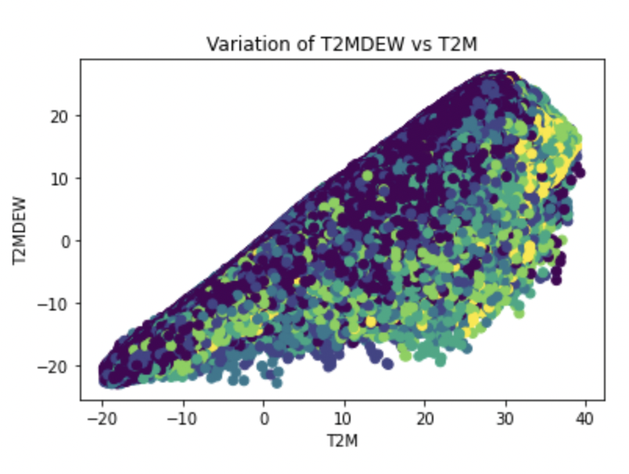
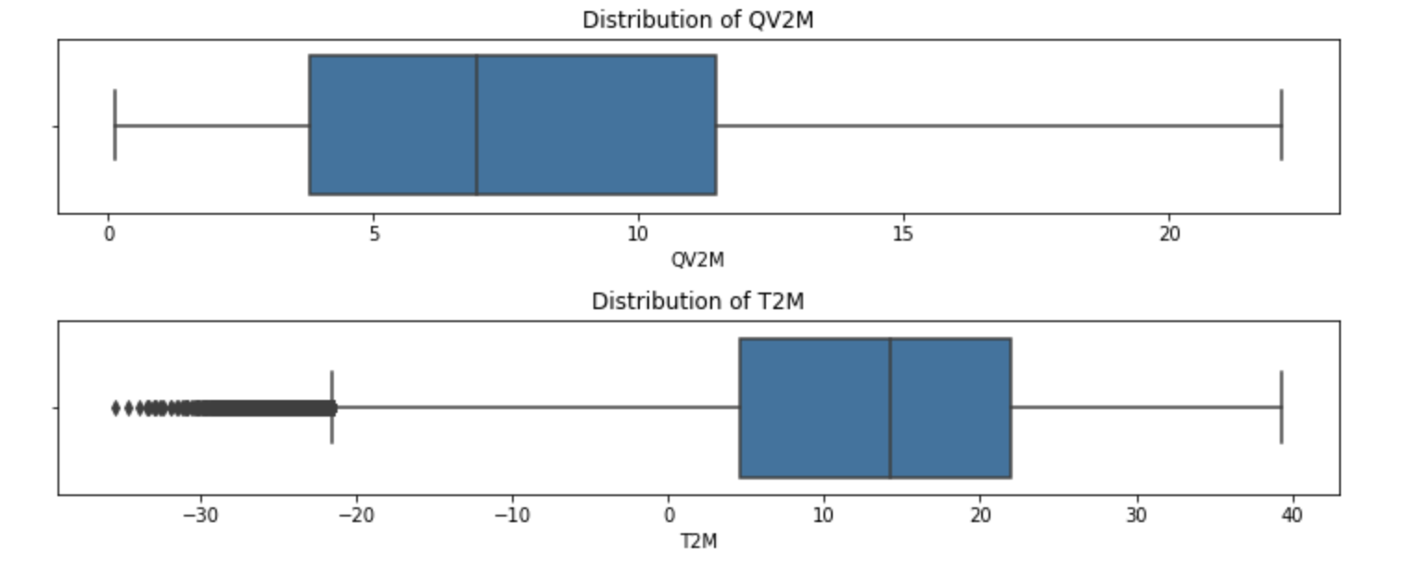
Exploratory Data Analysis

Slide 10

Machine Learning Models
Decision Tree (DT)
DT with SMOTE Upsampling
DT with Near Miss Downsampling
DT with SMOTE Upsampling and PCA
DT with Near Miss Downsampling and PCA
DT with SMOTE Upsampling and LDA
DT with Near Miss Downsampling and LDA
DT without resampling
Hyperparameter Tuning
K-Nearest Neighbours (KNN)
Other Models
KNN with SMOTE Upsampling
KNN with Near Miss Downsampling
KNN without resampling
Hyperparameter Tuning
Naïve Bayes without resampling
Random Forest without resampling
SVM with Near Miss Downsampling
Hyperparamter Tuning

Slide 11
Performance Comparison
Algorithm | Accuracy | Precision | Recall | F1 Score | Cohen Kappa Score
Random Forest without resampling | 0.808959 | 0.796925 | 0.808959 | 0.79869 | 0.654981
KNN without resampling | 0.798651 | 0.798294 | 0.798651 | 0.798471 | 0.657498
KNN with SMOTE Upsampling | 0.795267 | 0.801758 | 0.795267 | 0.798198 | 0.657827
Decision Tree with SMOTE Upsampling | 0.764228 | 0.772588 | 0.764228 | 0.767987 | 0.607222
Decision Tree without resampling | 0.763337 | 0.762305 | 0.763337 | 0.762809 | 0.596681
Decision Tree with SMOTE Upsampling and PCA | 0.691158 | 0.721815 | 0.691158 | 0.703299 | 0.504504
Decsion Tree with SMOTE Upsampling and LDA | 0.602809 | 0.674628 | 0.602809 | 0.628327 | 0.394723
Naive Bayes without resampling | 0.585144 | 0.44991 | 0.585144 | 0.480441 | 0.080746
SVM with Near Miss Downsampling | 0.299534 | 0.512324 | 0.299534 | 0.362867 | 0.078111
KNN with Near Miss Downsampling | 0.232508 | 0.566489 | 0.232508 | 0.268879 | 0.093552
Decision Tree with Near Miss Downsampling | 0.224805 | 0.543185 | 0.224805 | 0.2626 | 0.07876
Decision Tree with Near Miss Downsampling and LDA | 0.204748 | 0.514249 | 0.204748 | 0.249713 | 0.057772
Decision Tree with Near Miss Downsampling and PCA | 0.189016 | 0.520894 | 0.189016 | 0.224072 | 0.059722
Experimental results suggest that Random Forest without resampling and KNN without resampling perform the best amongst all other models in terms of Accuracy, Precision, Recall, F1 Score and Kappa Score
While feature extraction using linear PCA & LDA do not fare well on the non-linear data, as they lead to drop in accuracy
SMOTE Upsampling models drastically increases the computational time, and produces similar accuracy as those without any resampling
The effect of class imbalance, are however still reflected on all models without resampling, as seen in the ROC curves

Slide 12

Conclusion and Future Work
Challenges
Data Volume – 2 Million + records, made processing too complex in terms of time and application memory
Class Imbalance - Heavily imbalanced data with over 1.7M records (60%) for class 0 alone
Non-Linearity – Non-Linear data, due to which linear PCA and LDA were inefficient
Kernel Computations - Kernel methods such as Kernel PCA, Kernel SVM with any type of kernel required more computational resources than what is available in free versions of coding platforms
Hyperparameter Tuning – Had to settle for experimenting with limited parameter options due to time and resource complexity
Future Work
Experiment further with non-linear dimensionality reduction methods such as TSNE, Isomap, etc. for feature extraction
Creating a separate binary classifier for predicting whether there is a drought, and if yes, build a multi-class classifier to further predict the level of drought in order to achieve better accuracies for each class

Slide 13
Thank You!

Slide 14

References

